Slide 1
Stock View -Demo
Author : Sumod Madhavan

Slide 2
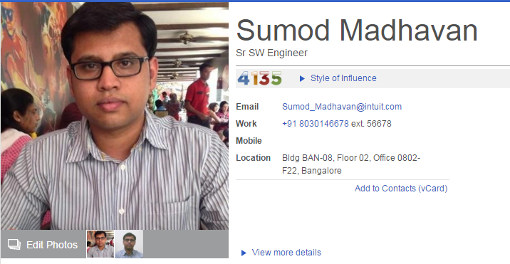
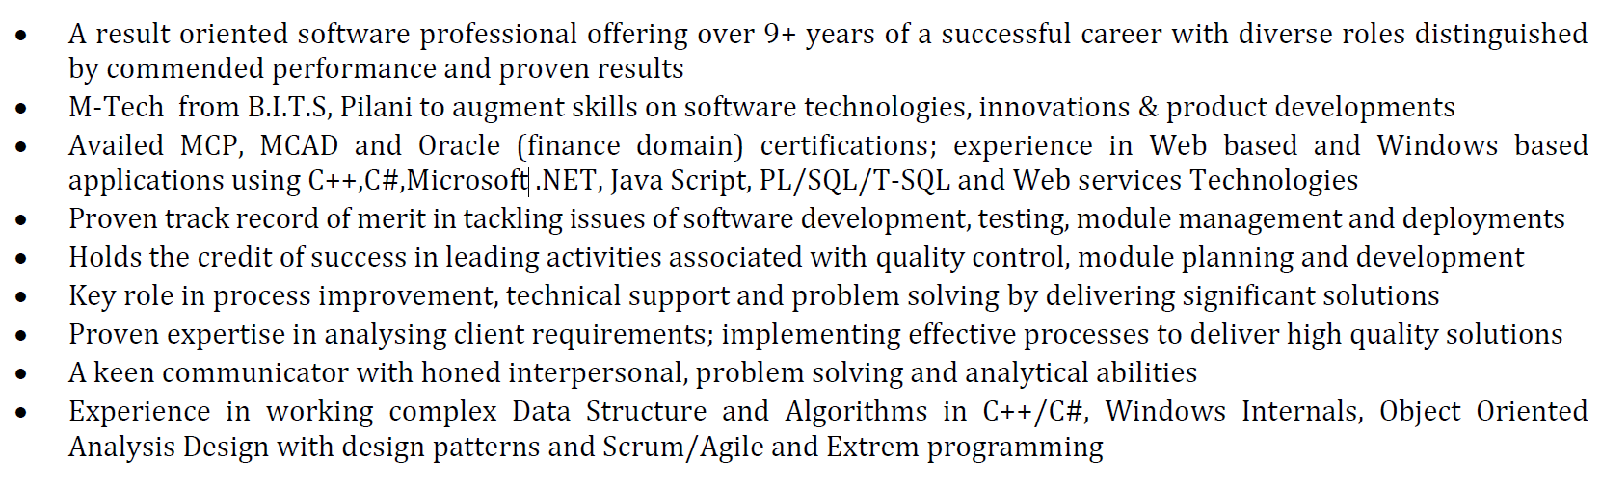
Introduction

Slide 3






Product work experience

Slide 4


Product Portfolio

Slide 5
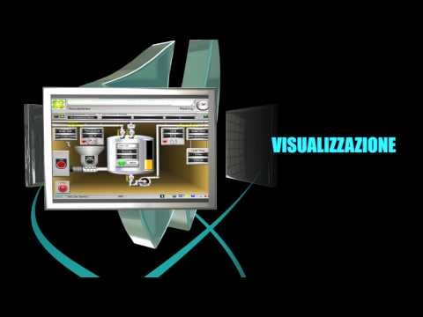

Product Portfolio

Slide 6
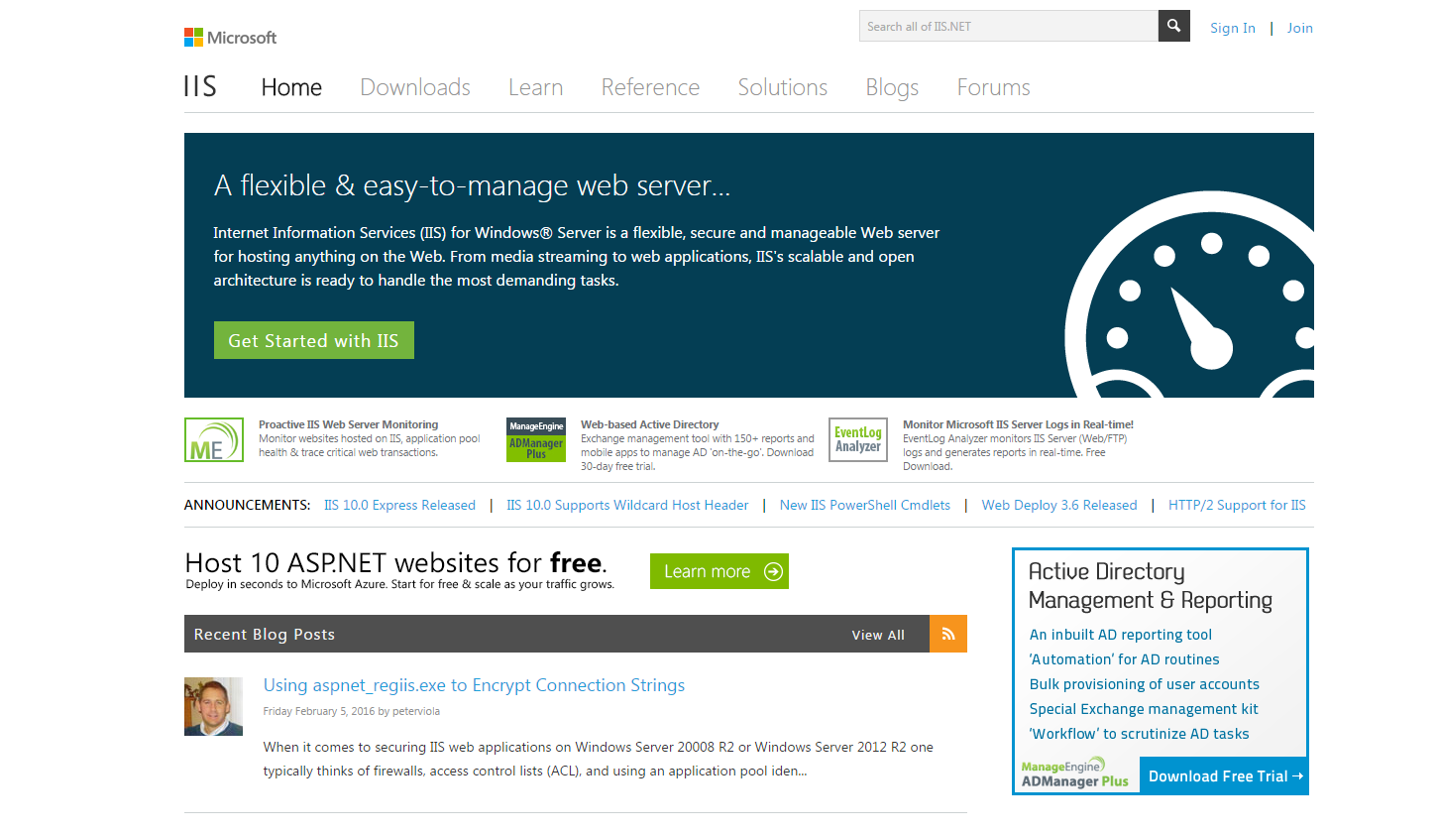

Product Portfolio

Slide 7
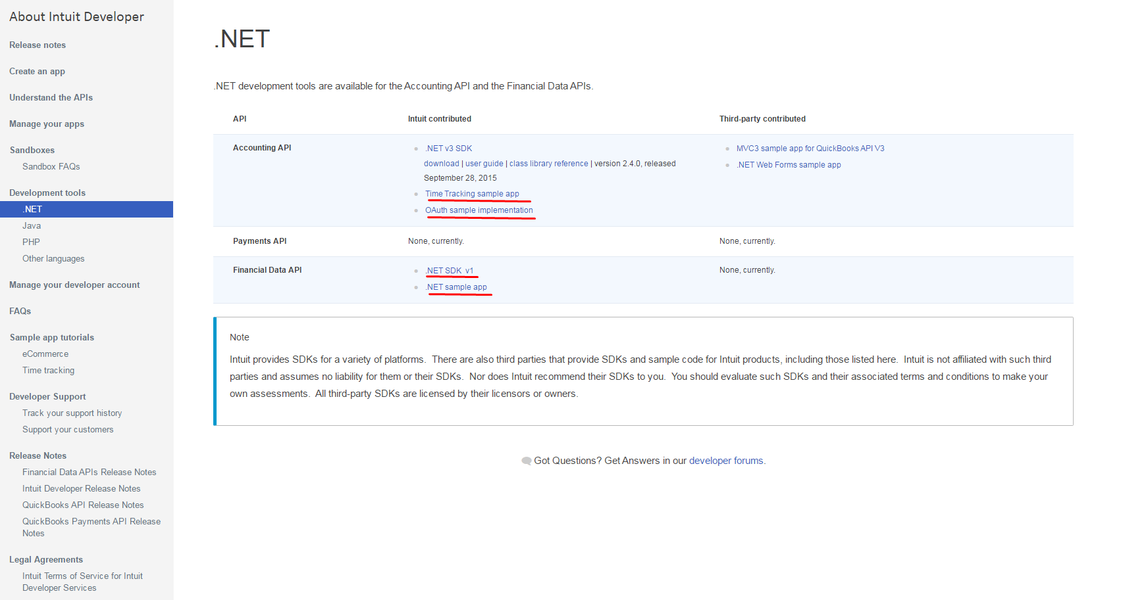
My work at Intuit Developer Group

Slide 8
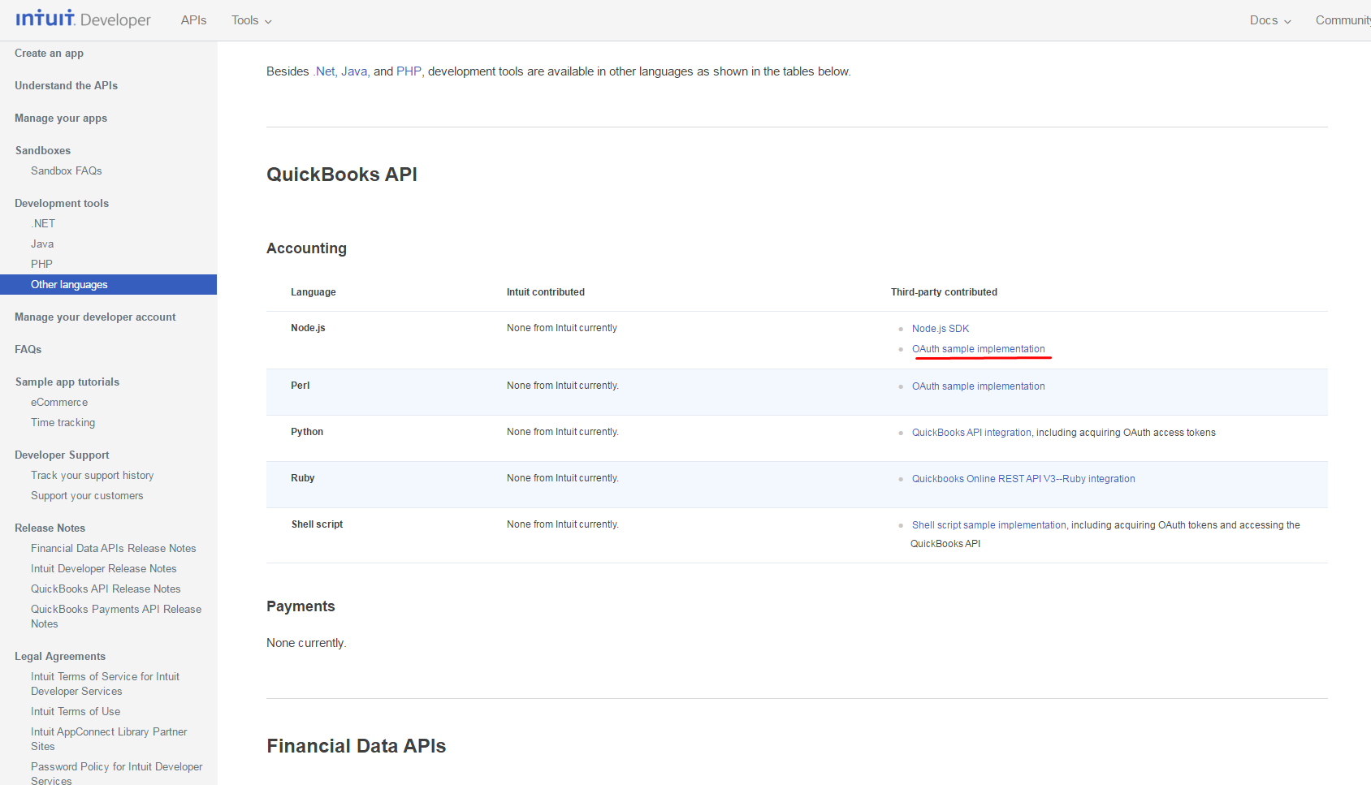
My work at Intuit Developer Group

Slide 9
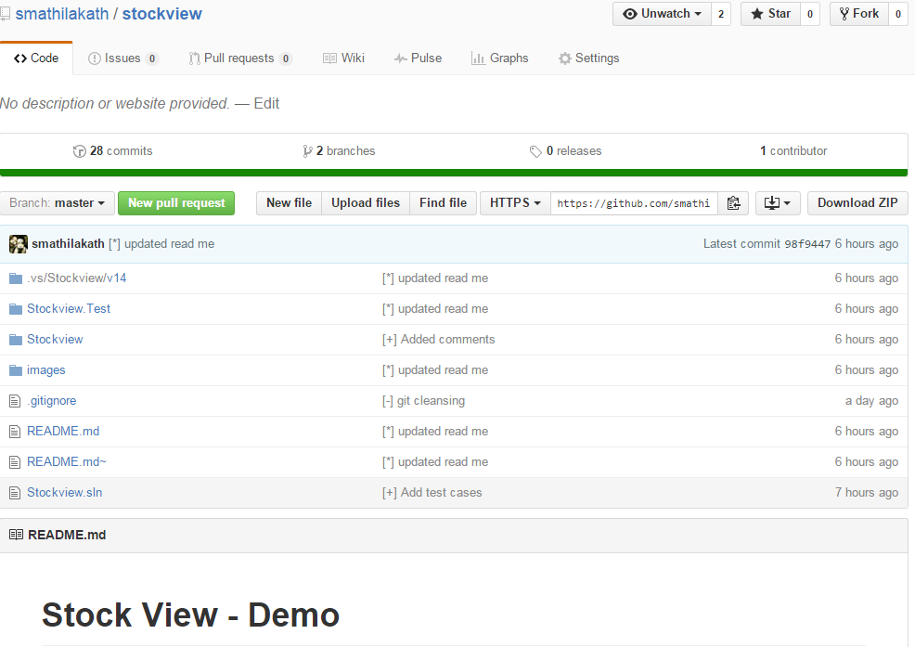
Case Study - Demo

Slide 10
Questions ?

